Slide 1

Chandigarh University
Department of Mathematics
B.Tech. CSE (Core/DS/IT/CC)
Semester-3
Subject Code:25MTT-202
Discrete Mathematics
Unit-3 (Chapter- 3.1.1)
Dr. SARTAJ
DISCOVER . LEARN . EMPOWER

Slide 2

CO mappings

Slide 3

CO-PO mappings
Note: Degree of relevance/correlation: 1-Low, 2-Medium, 3-High, Blank or ‘- ‘- Nil

Slide 4
Topics Overview
Relation and their Types
Conclusions
Video links
References

Slide 5
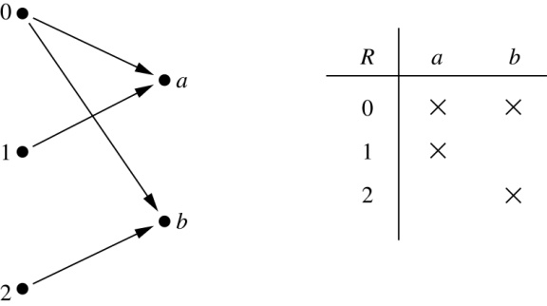
Binary Relations
Definition: A relation R from a set A to a set B is a subset of
A × B Or R ⊆ A × B
Example:
Let A = {0,1,2} and B = { a, b}
R = {(0, a), (0, b), (1,a) , (2, b)}
is a relation from A to B.
We can represent relations from
a set A to a set B graphically or
using the adjacent fig:
ns

Slide 6
Binary Relations
Definition: A binary relation R on a set A is a subset of A × A or a relation from A to A.
Example:
Suppose that A = { a, b, c}. Then R = {( a, a),( a, b), ( a, c)} is a relation on A.
Let A = {1, 2, 3, 4}.
The ordered pairs in the relation R = {( a, b) | a divides b} are
(1,1), (1, 2), (1,3), (1, 4), (2, 2), (2, 4), (3, 3), and (4, 4).
ns

Slide 7
Binary Relations
Question: How many relations are there on a set A?
Solution: Because a relation on A is the same thing as a subset of A ⨉ A, we count the subsets of A × A. Since A × A has n² elements when A has n elements, and a set with m elements has 2^{m} subsets, there are subsets of A × A. Therefore, there are relations on a set A.
ns

Slide 8
Reflexive Relation
Definition: R is reflexive iff ( a, a) ∊ R for every element a ∊ A. Written symbolically, R is reflexive if and only if
∀x[ x∊ A ⟶ ( x, x) ∊ R]
If A = ∅ then the empty relation is reflexive vacuously. That is the empty relation on an empty set is reflexive!
Example: The following relations on the integers are reflexive:
R₁ = {( a, b) | a ≤ b},
R₂ = {( a, b) | a = b or a = −b}
The following relations are not reflexive:
R₃ = {( a, b) | a > b} (note that 3 ≯ 3),
R₄ = {( a, b) | a = b + 1} (note that 3 ≠3 + 1)
ns

Slide 9
Symmetric Relation
Definition: R is symmetric iff (b,a) ∊ R whenever (a,b) ∊ R for all a,b ∊ A. Written symbolically, R is symmetric if and only if
∀x ∀y [( x, y) ∊R ⟶ ( y, x) ∊ R]
Example: The following relations on the integers are symmetric:
R₁ = {( a, b) | a = b or a = −b},
R₂ = {( a, b) | a + b ≤ 3}
The following are not symmetric:
R₁ = {( a, b) | a ≤ b} (note that 3 ≤ 4, but 4 ≰ 3),
R₂ = {( a, b) | a = b + 1} (note that 4 = 3 + 1, but 3 ≠4 + 1)
ns

Slide 10
Anti - Symmetric Relation
Definition: A relation R on a set A such that for all a, b ∊ A if ( a, b) ∊ R and (b,a) ∊ R, then a = b is called antisymmetric. Written symbolically, R is antisymmetric if and only if ∀x ∀y [( x, y) ∊R ∧ ( y, x) ∊ R ⟶ x = y]
Example: The following relations on the integers are antisymmetric:
R₁ = {( a, b) | a ≤ b},
R₂ = {( a, b) | a = b + 1}
The following relations are not antisymmetric:
R₃ = {( a, b) | a = b or a = −b}
(note that both (1,−1) and (−1,1) belong to R₃),
R₄ = {( a, b) | a + b ≤ 3} (note that both (1,2) and (2,1) belong to R₆).
ns

Slide 11
Transitive Relation
Definition: A relation R on a set A is called transitive if whenever ( a, b) ∊ R and ( b, c) ∊ R, then ( a, c) ∊ R, for all a, b, c ∊ A. Written symbolically, R is transitive if and only if ∀x ∀y ∀z[( x, y) ∊R ∧ ( y, z) ∊ R ⟶ ( x, z) ∊ R ]
Example: The following relations on the integers are transitive:
R₁ = {( a, b) | a > b},
R₂ = {( a, b) | a = b or a = −b}
The following are not transitive:
R₃ = {( a, b) | a = b + 1} (note that both (3,2) and (4,3) belong to R₅, but not (3,3)),
R₄ = {( a, b) | a + b ≤ 3} (note that both (2,1) and (1,2) belong to R₆, but not (2,2)).
ns

Slide 12
Activity-1
1. Given a set S = {1, 2}, list all its subsets. Also find all relations on S.
2. Consider these relations on the set of integers:
R₁ = {( a, b) | a ≤ b},
R₂ = {( a, b) | a = b},
R₃ = {( a, b) | a > b},
R₄ = {( a, b) | a = b + 1},
R₅ = {( a, b) | a = b or a = −b},
R₆ = {( a, b) | a + b ≤ 4}.
Which of these relations contain each of the pairs
(1,1), (1, 2), (2, 1), (1, −1), and (2, 2)?

Slide 13
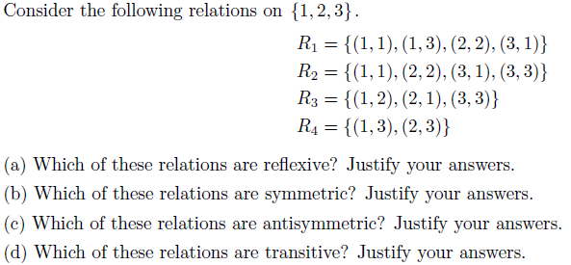
Activity-2

Slide 14
Conclusion
Relations and their types are discussed.
Related examples are given.
ns

Slide 15
Video Links
https://youtu.be/yQ03lewFU8U?si=KIdJ3uNqZS26zN-Z

Slide 16
References
Sr. No. | Author | Name of the Book | Publisher | Year of Publication
1 | Kenneth H. Rosen | Discrete Mathematics and Its Applications | McGraw-Hill | 2019
2 | C. L. Liu | Elements of Discrete Mathematics | McGraw-Hill | 1996
3 | J. P. Tremblay, R. Manohar | Discrete Mathematical Structures with Applications to Computer Science | Tata McGraw Hill | 2001
4 | Kolman, Busby, Ross | Discrete Mathematical Structures | PHI | 2001
5 | Narsingh Deo | Graph Theory with Applications to Engineering and | PHI | 2017

Slide 17
Thanks!!!

